Slide 1
Startup Companies Analysis
Group 2
Ashraf Adel 196280
Farah Aymen 194233
Aissatou Aida 197346

Slide 2
TABLE OF CONTENTS
01
02
03
Introduction & PreProcessing
Analysis OverView
Analysis Results & Conclusion
Scope of the data and points of interests
Analyising the data from different critical points and aspects
Results deduced from the analysis and its effectiveness

Slide 3
Introduction
Decision making while kickstarting a company can be rather critical.
Analysis and further insights can be a starting guide!

Slide 4
Our Scope
Our data gathers information of around 60 thousand startup company regarding their name, location, category, etc.
The goal is to determine the main crucial factors that may affect the rise or fall of a startup.(e.g. fundings, investments, acquisitions, taxes, etc.).
Acquire additional data to support further insights into the analysis

Slide 5
Cleaning our Data
Organize
Impute missing values
Handle Outliers
Merge Data
Organize the dataset and determine what needs to be cleaned
Fill missing data with average values
Drop irrelevant data
Join all data together to form a solid picture

Slide 6
Obstacles Faced

Slide 7
Finding a source for scrapping
The original data was brought from crunch base, but scrapping additional data from it was impossible as it was “immune” to scrapping.
The website was so secure it detected anonymous scrapping bots and other techniques.

Slide 8
Thinking of another source

Slide 9
Another failed attempt
What is another source that can have all information about any company? LinkedIn!
Unfortunately, it detected the scrapping bots and blocked it
But, this isn’t the end…

Slide 10

Finding the Solution!
An API that displays information of any company it has in its database.
So, we scrapped the companies’ annual revenue, their country, number of technologies used, and number of employees.

Slide 11

Analysis Questions

Slide 12
Question:
01
Can the factors that affect a start-up’s growth be determined?

Slide 13
Solution:
01
Two Factors Are Considered:
1. Amount Of Funds
2. Time Before First Fund

Slide 14
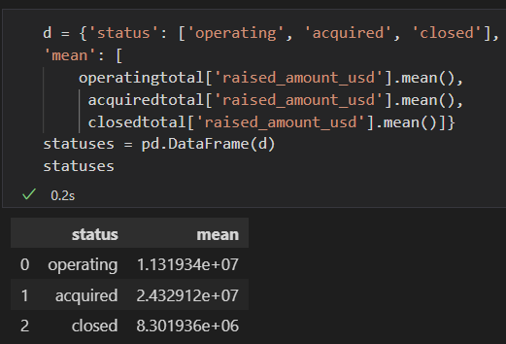
1. Amount Of Funds
Steps:
1. Joined companies and rounds dataframes
2. Got the average of all funding in operating, closed, and acquired companies

Slide 15
1. Amount Of Funds
Visualization:
Analysis:
Company Status
Acquired companies’ “funds” makes sense
Operating
operating funds > closed funds
Acquired
Conclusion:
Closed
Getting funded is critical??
0 5 10 25
Raised Funds in 1 million (avg)

Slide 16
~ distribution of companies
Visualization:
Analysis:
In #funds & #companies, the operating companies are dominating the dataset
11%
8%
operating companies >>> closed companies
82%
Conclusion:
Getting funded is not critical
operating
acquired
closed

Slide 17
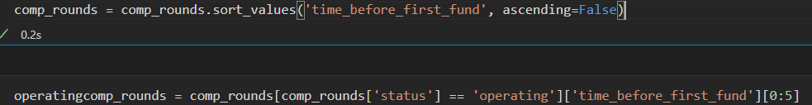
2. Time before first fund
Steps:
1. Created a feature that represents the time (in days) between a company’s establishment date and the first time it got funded
2. Sorted based on created feature and compared the first 5 companies in the two dataframes
3. Split the merged companies/rounds dataframe (from approach 1) to 2 dataframes representing operating and closed companies

Slide 18
2. Time before first fund
Visualization:
Analysis:
Days before
first fund
operating
Time for operating companies to get funded >>> closed companies
closed
100k
80k
60k
40k
20k
This large gap leads us to believe that the companies were still operating regardless of it getting funded
Conclusion:
Group A Group B Group C Group D Group E
The time it takes for a company to get its first fund isn’t critical to its success
Groups of operating and closed companies

Slide 19
Solution:
01
Two Factors Are Considered:
1. Amount Of Funds
2. Time Before First Fund

Slide 20
Question:
02
Which countries are most probable to have the most failed startups?

Slide 21
Categorizing the companies
We will categorize the companies according to their status: operating, closed, acquired or IPO so we can compare between them.
Company Status
Operating
Closed
Acquired
IPOs

Slide 22
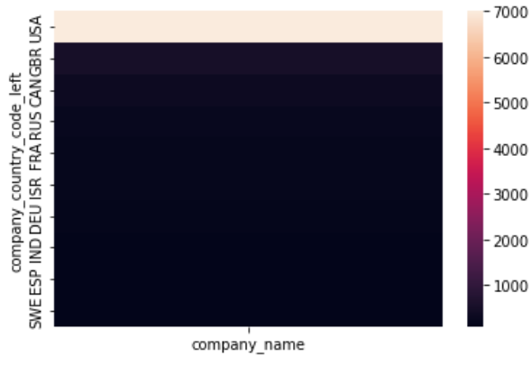
Grouping by the country
We will group by the country to see the number of companies (of each status) in each country to gain insight if there's a massive difference between the number of operating companies and closed ones in a single country.
The heatmap that illustrates. that the US has the most closed companies while others have less

Slide 23
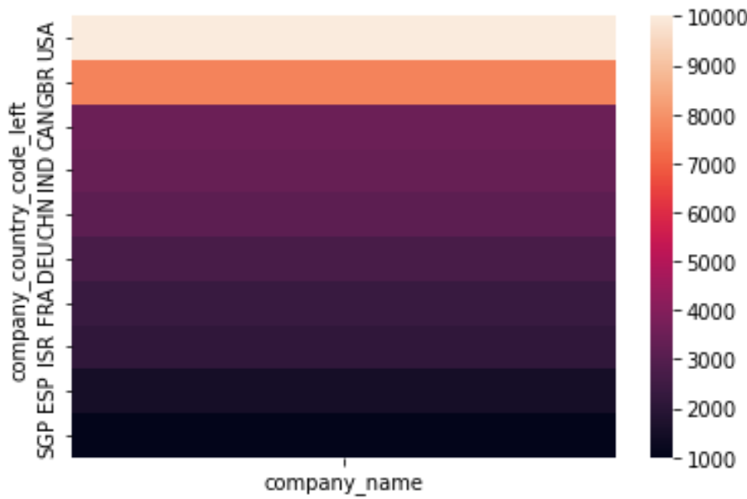
Grouping by the country
The heatmap yet again shows that the US has the most operating companies which seems noticeable because it also had the most closed companies.
After looking in the closed and operating companies we see that we still can't determine if the country has more operating companies than the closed or not, so let's take one country and compare.

Slide 24
Focusing on the USA
The previous heatmaps show us how although the US has strong economics and massive amount of investors, it has a bulk of closed companies, but compared to operating it's only 0.08 (7956/92228) of it. So, this reflects that The US must have facilities and enough fundings for startups.

Slide 25
Conclusion
As the ratio the ratio between the closed to operating companies increases, the more difficult it is for a company to start up.
This will lead us to look closed into factors that makes those countries a difficult place to start a company.

Slide 26
Question:
03
How the number of investors in a country can affect the number of successful companies?

Slide 27
Focusing on Investors
The number of investors investing in a company can be a great factor in influencing the success of this company.
Let’s narrow down the investors who are in the same country of the company, and categorize the companies by their status.

Slide 28
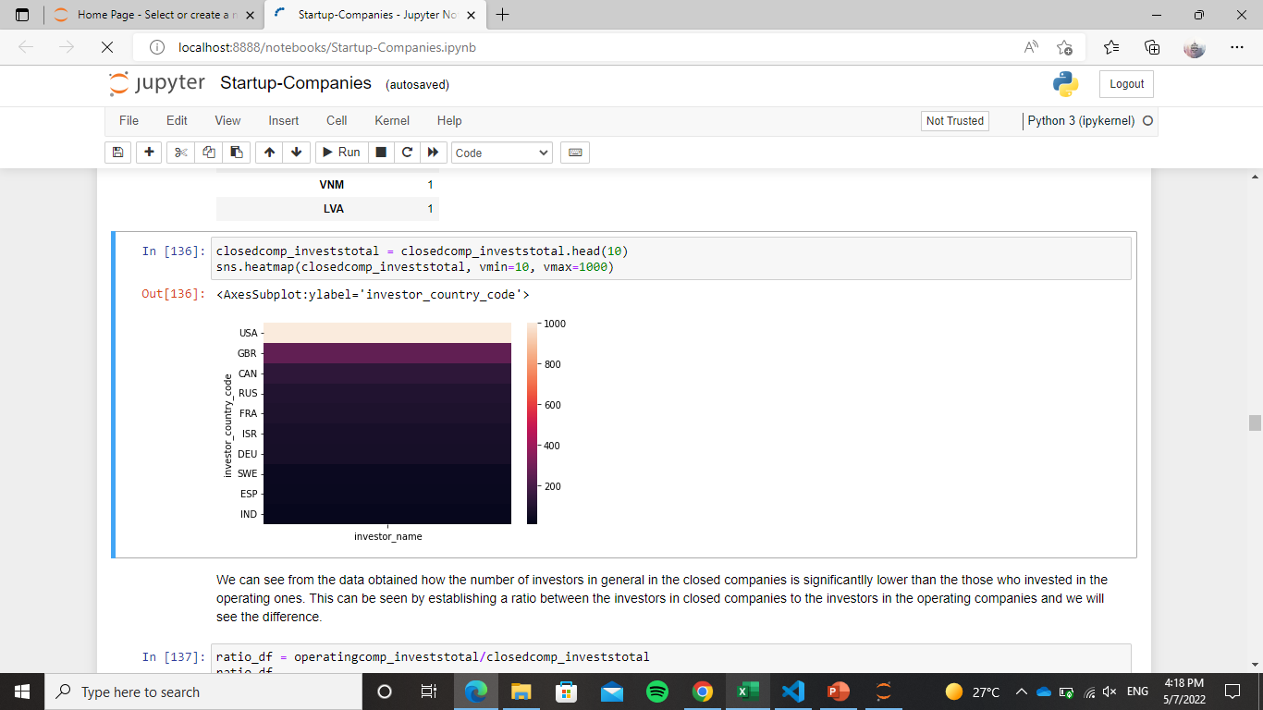
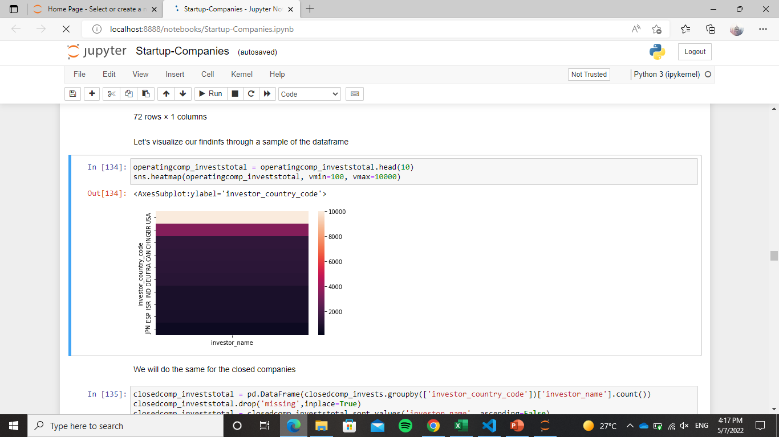
Investors of the closed and operating companies
As seen, the number of investors in each country investing in the operating countries is way less than the closed ones.
To illustrate more, constructing a ratio will make it clearer.
Closed Companies
Operating Companies

Slide 29
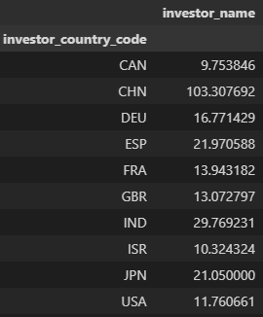
Constructing ratio
Constructing a ratio of the number of operating companies to closed ones that investors invested in according to the countries
it is clearly seen that all of the ratios are > than 1 which means that more investors invested in those companies that helped them in sustaining being operating.

Slide 30
Conclusion
Investing plays an important part in keeping the company operating. As the number of investors increases, the chance of success increases.
The companies that had much investors to invest it made it other than those who haven’t had many.

Slide 31
Question:
04
Which category attracts most funding?

Slide 32
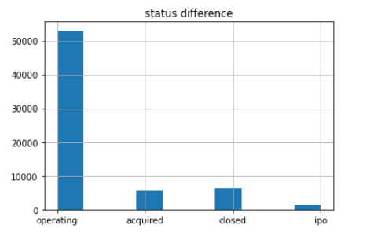
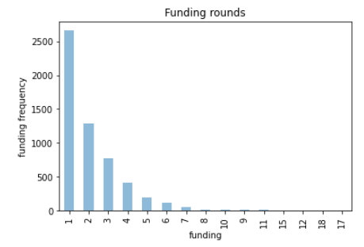
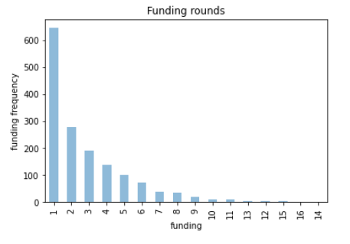
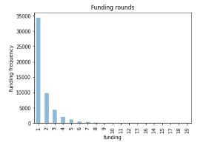
Acquired companies
IPO companies
Operating companies

Slide 33
Question:
05
How many investors do we have in different countries and which country dominates?

Slide 34
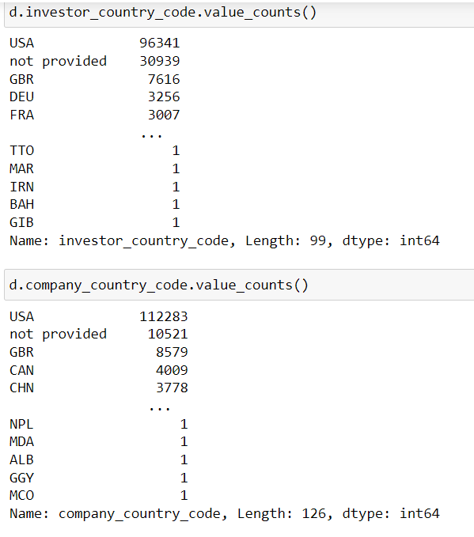
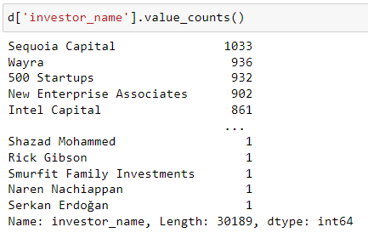
Most famous investors
Investor and company country codes

Slide 35
Question:
06
Can the factors that affect a start-up’s growth be determined?

Slide 36
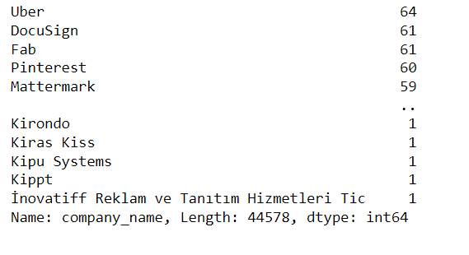
Most famous companies among investors
How many specializations do we have?

Slide 37
Question:
07
Companies specializations and the ones of interest in the investor’s point of view

Slide 38
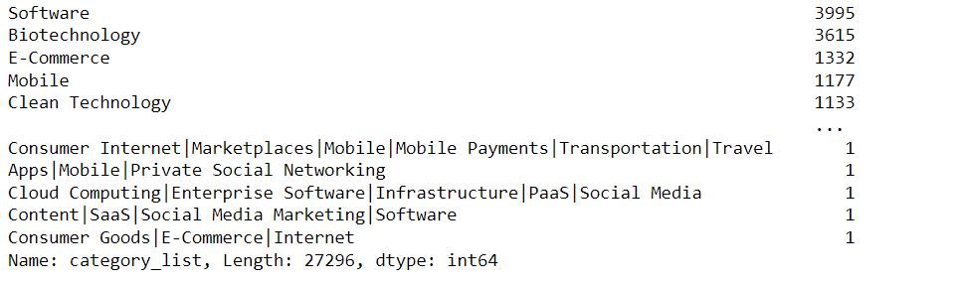
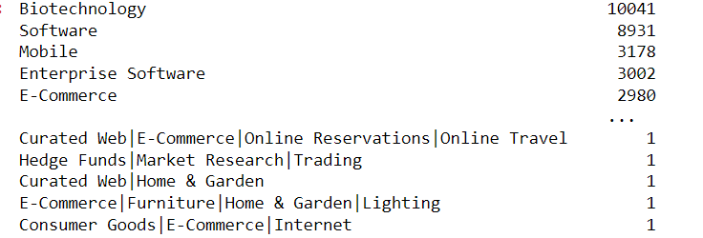
Important fields in companies point of views
Important fields in investors point of views

Slide 39
Question:
08
Are most of the investors also acquirers?

Slide 40
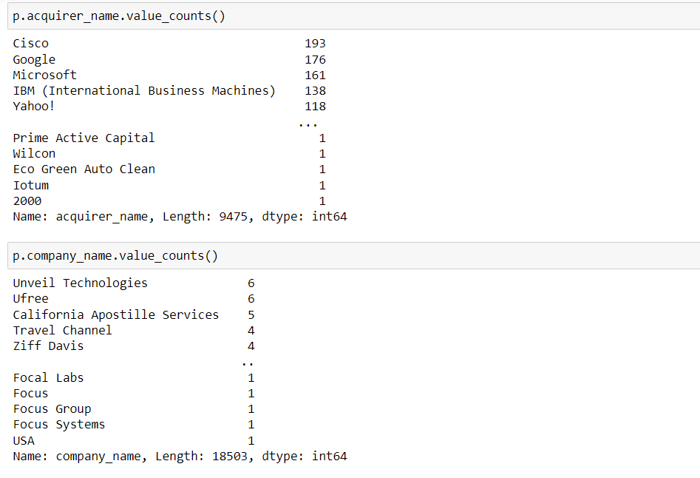
Acquirer names and company names in the acquisition data set

Slide 41
Scrapping-based Questions
scrapped the companies’ annual revenue, their country, number of technologies used, and number of employees from Apollo website using the following steps:

Slide 42
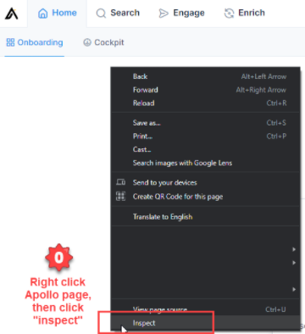
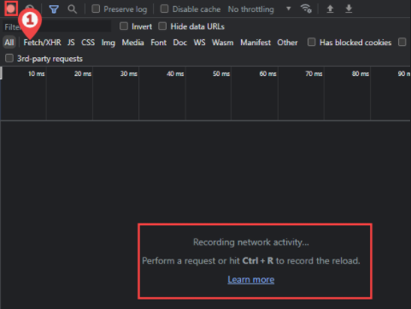
Step 1: obtained cookies from website:

Slide 43

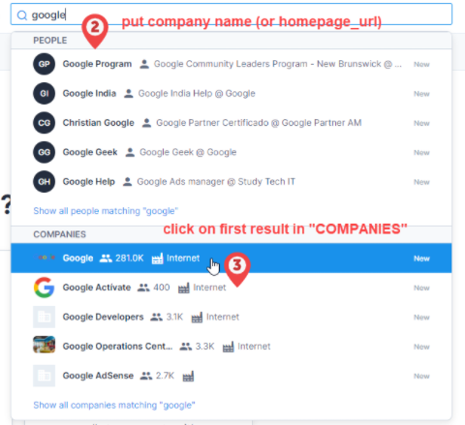
Step 1: obtained cookies from website:

Slide 44
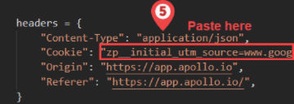
Step 1: obtained cookies from website:

Slide 45
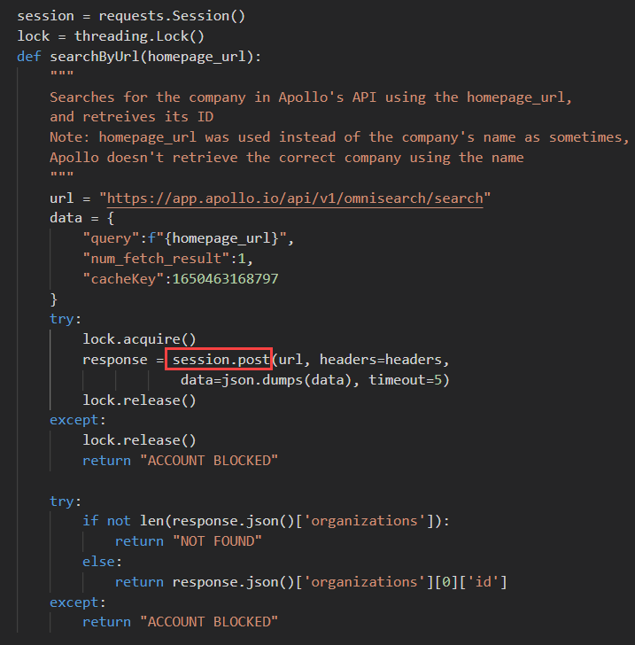
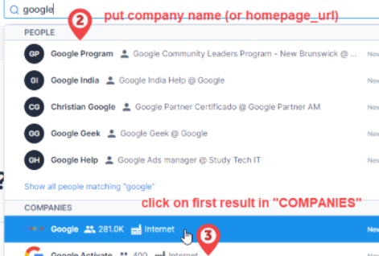
Step 2: Code to post a request to a company’s “id” that Apollo stores:

Slide 46
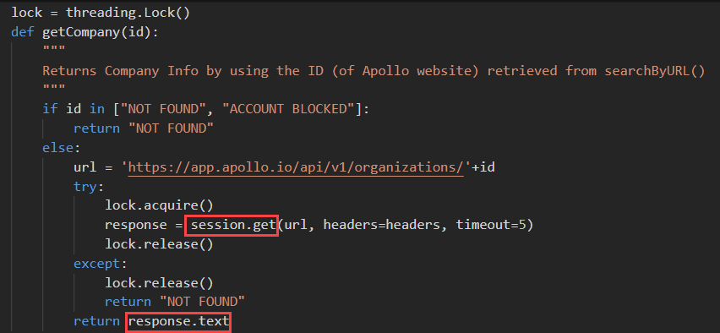
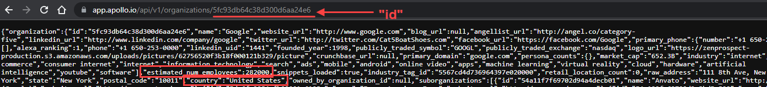
Step 3: Using that “id” to get the company’s link and retrieve the website’s info (JSON string):

Slide 47
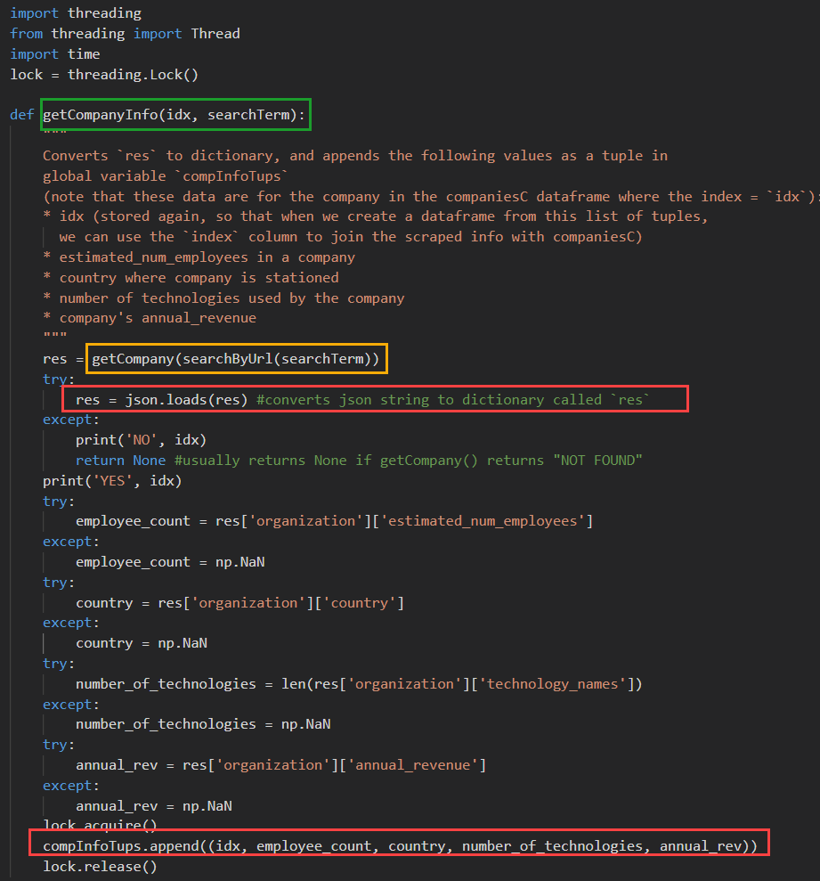
Step 4: converting the website’s JSON to a dictionary and retrieving the required info:

Slide 48
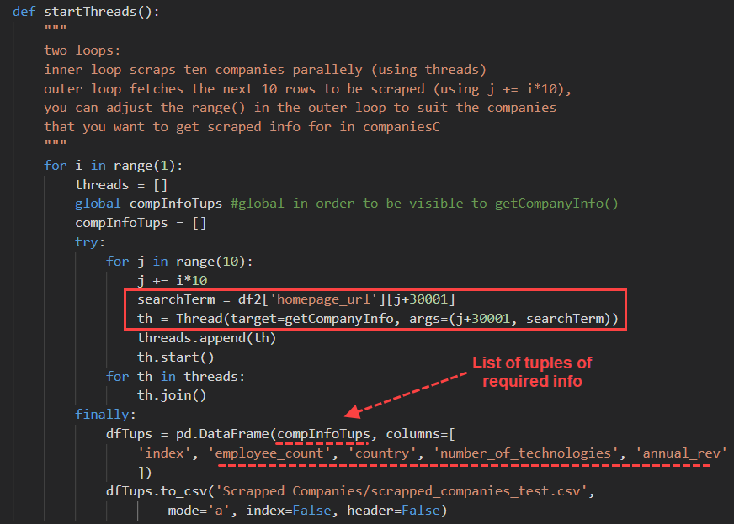
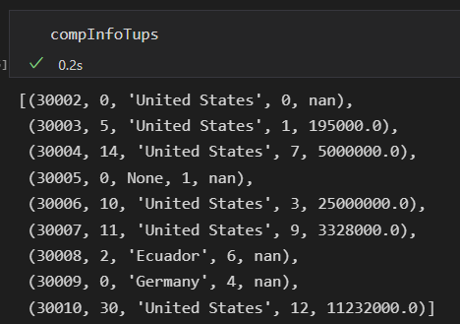
Step 5: retrieving required info from getCompanyInfo() in batches of 10 threads (i.e. ten simultaneous requests)
Result:

Slide 49
Questions that used the scrapped info:

Slide 50
Time-Changing Question:
09
Do country taxes play an important factor in deciding a start-up’s success?

Slide 51
Solution:
09
Two Approaches:
1. Taxes W/ Company Status
2. Taxes W/ Avg Funding

Slide 52
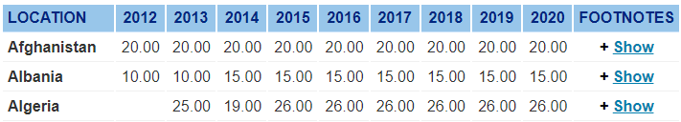
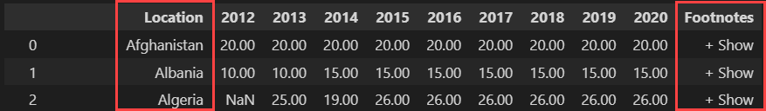
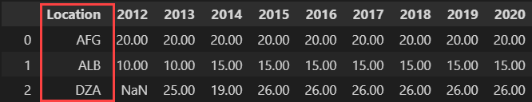
1. Taxes W/ Company Status
Steps:
1. Scraped countries’ taxes from KPMG
pd.read_html(pgSrc)
pycountry.countries.get(name=country)
.alpha_3
2. Cleaned scraped data

Slide 53
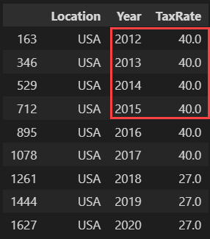
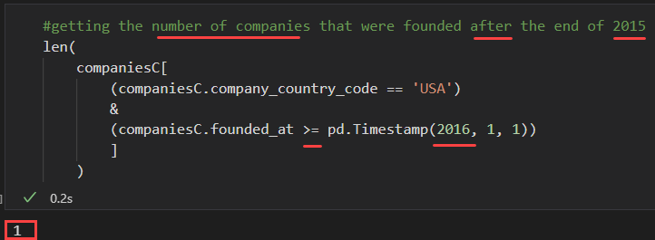
1. Taxes W/ Company Status
Steps:
4. Initially chose USA
However…
3. Visualized #companies in each country in our dataset to choose taxes for the country that appeared the most
USA
35K
5K
N/A
4K
GBR
2.5K
CAN
#Companies
#Country Code

Slide 54
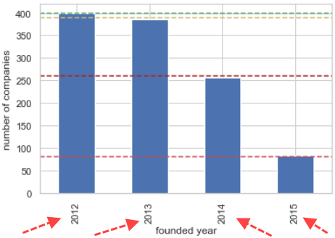
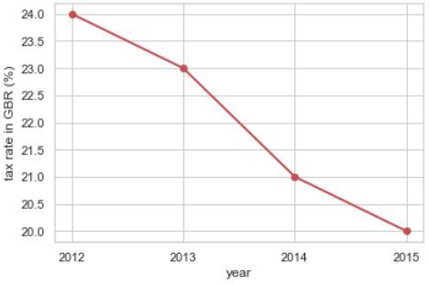
1. Taxes W/ Company Status
Steps:
5. Then we tried GBR:
3. Visualized #companies in each country in our dataset to choose taxes for the country that appeared the most
USA
35K
5K
N/A
4K
GBR
2.5K
CAN
#Companies
#Country Code

Slide 55
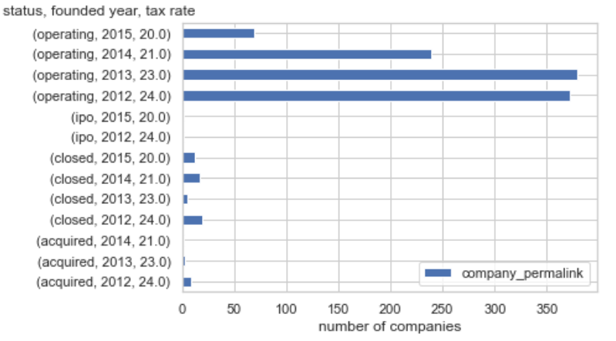
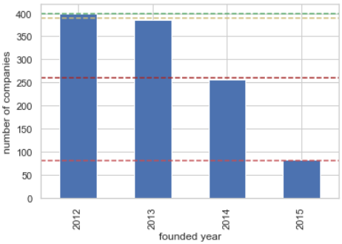
1. Taxes W/ Company Status
Visualization:
Analysis:
Recall: most were operating, and #companies aren’t distributed evenly throughout the years

Slide 56
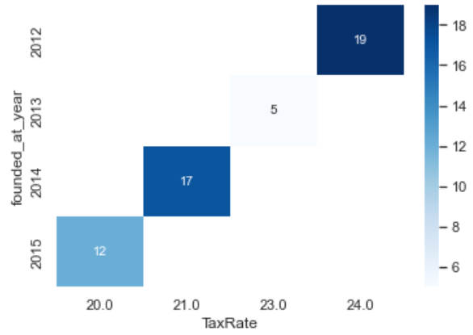
1. Taxes W/ Company Status
Visualization:
Analysis:
#closed companies:
2012 > 2014 > 2015 > 2013
(24) (21) (20) (23)
Therefore, no apparent correlation
Conclusion:
Tax rate doesn’t affect a company’s status

Slide 57
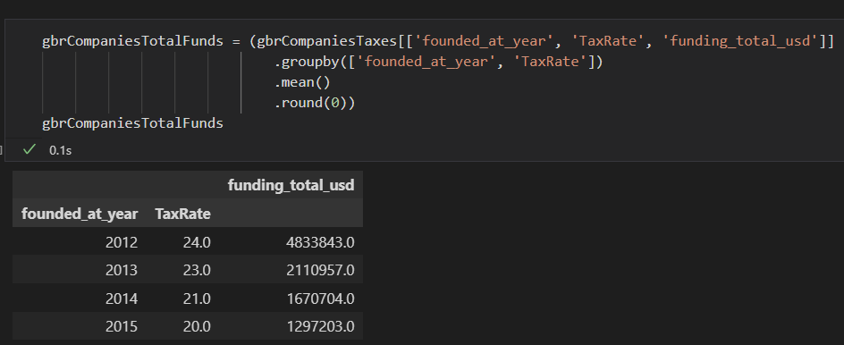
1. Taxes W/ Avg Funding
Steps:
1. Grouped by the company’s establishment year and the tax rate to obtain the average of total companies’ funding at that year

Slide 58
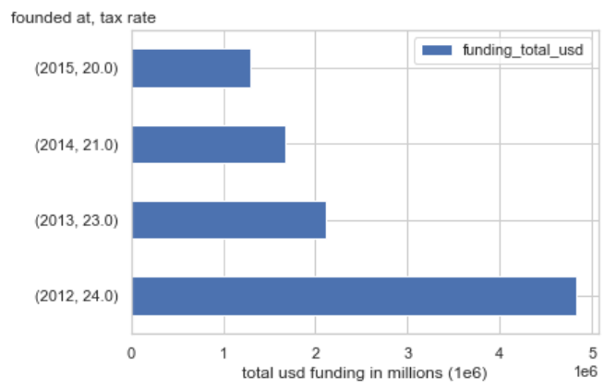
1. Taxes W/ Company Status
Visualization:
Analysis:
Recall: #companies aren’t distributed evenly throughout the years
Let’s append that info on
our horizontal bar graph!

Slide 59
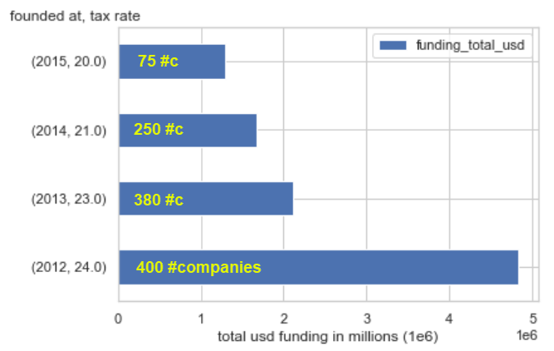
1. Taxes W/ Company Status
Visualization:
Analysis:
2012’s #c ~= 2013’s #c
2012’s company Funds >>> 2013’s company Funds
2014’s #c >> 2015’s #c
2014’s company Funds ~= 2015’s company Funds
Conclusion:
Tax rate has a slight inverse correlation with stockholders funding a company

Slide 60
Solution:
09
Two Factors Are Considered:
1. Taxes W/ Company Status
2. Taxes W/ Avg Funding

Slide 61
Question:
10
Dos the number of employees
affect the success of the company?

Slide 62
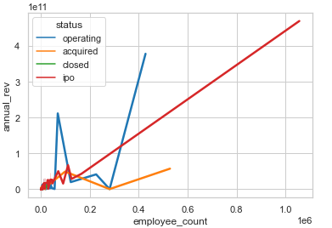
Testing relationship
Let's see if the relationship between the number of employees is proportional with the success of the company in other words operating or not.
we will correlate it with the annual revenue of the company. The annual revenue will definitely show how the company is doing.
There's seemingly a direct proportional relation between the number of employees and the annual revenue.

Slide 63
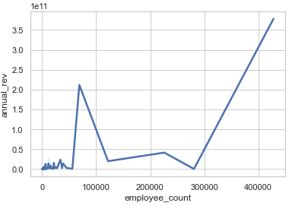
Operating Companies
it is seen that with the increase in the number of employees, the annual revenue increases with it.
Looking at the graph there is what seems like a point where if it's reached, there is a clear direct relation between both attributes.
It means that companies may suffer in achieving high profit until a certain point.

Slide 64
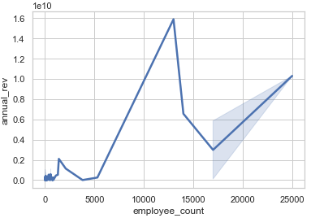
Closed Companies
From the previous graph, a similar pattern is recognized from the previous graph. Here, the closed companies the maximum number of employees and annual revenue reached is noticeably way less than the operating companies which is reasonable. Having more than 5000 achieve reasonable profits.

Slide 65
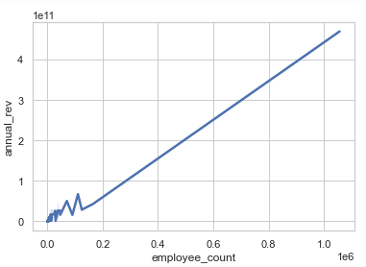
IPO Companies
IPOs can have a huge number of employees since they are publicly offered for stock sharing
From the pattern seen from past graphs, hiring more employees help in increasing annual revenues.
By this graph, it is clearly seen that the number of employees is directly proportional with the number of employees.

Slide 66
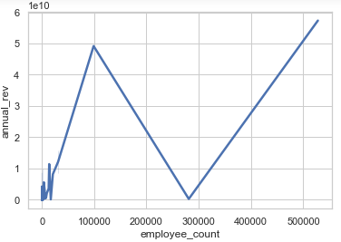
Acquired Companies
Since those companies are acquired so having much employees should be achievable due to the addition of the old employees to the ones working in the acquired one.
So, the increase of employees definitely helped in increasing the annual revenue of the company.

Slide 67
Conclusion
In conclusion, the number of employees can be considered directly proportional with the annual revenue although of course there are other factors that affect the revenue, but hiring intel and labor can increase productivity and its cost doesn't impact the company in a negative manner.

Slide 68
Question:
11
Can the number of technologies used by companies affect the rate of its success or failure?

Slide 69
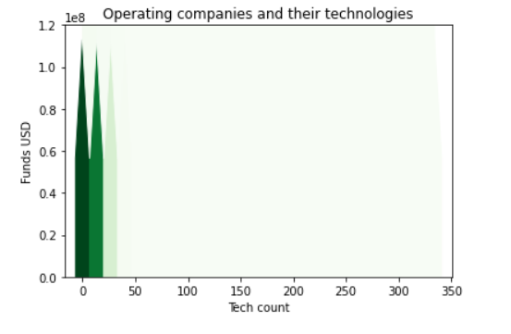
Cases
High funding and little technology count
High funding and high technology count
Low funding and high technology count
Why acquisition happens?

Slide 70
Final THoughts

Slide 71
THANKS
Do you have any questions?

